Slide 1

Credential Verification
Course- Blockchain and Cryptocurrencies
Submitted by-
Tarun Agrawal (MT2017127)
Pankaj Gupta (MT2017078)
Submitted to-
Prof. Aashish Chaudhary

Slide 2

GOAL
Removal of the intermediate third party for ensuring the authenticity of certificate.
Instant verification of the authenticity of certificates through blockchain.
Reduces the amount of hard copied certificates to be carried along.
The recipients decide with whom they want to share the certificate thereby maintaining the privacy of the certificates.

Slide 3




Current Situation
5. Submit credential verification slip
STUDENT
EMPLOYER
1.Please verify my credentials
4. Verified by third party
2. Are the credentials valid?
VERIFIER THIRD PARTY
Issuer
(Takes a lot of time and money)
3. Response

Slide 4

Non Blockchain Solution
All issuing authorities maintain their own verification portal .
Student verify their credentials from portal and show verification receipt to employers.
Limitation-
The system is centralized to issuing authorities.
What happens if authority went down?

Slide 5
Our Approach
A consortium blockchain where-
Issuing Authorities are permissioned participants.
Students are non-permissioned participants.
The hash of issued certificates stored on blockchain.
Employers can use the blockchain to verify the certificates .

Slide 6
Tools & Technologies Used
Hyperledger Fabric & Composer.
Rest API
Blockchain to provide-
Self-sovereignty
Trust
Disintermediation
Immutability

Slide 7

KEY SET PROVIDER
Work Flow:-
ISSUER
Private member
(access to all transactions)
Provide Identity
RECIPIENT
Public members
(access to verify transactions)
Certificate
CertId:
issuerId:
Title:
Recipient:
Date:
Digital
Certificate
Digital
Format
(pdf, image,
text)
Sign by Skissuer

Slide 8
Transactions
Issuer Transaction
Verifier Transaction
Transaction ID
Certificate ID
Certificate Link
Hash of Certificate
Skissuer
Pkrecipient
Transaction ID
Certificate
Wallet
Transaction Id
Certificate Id
Certificate Link
Issuer/Recipient ID

Slide 9
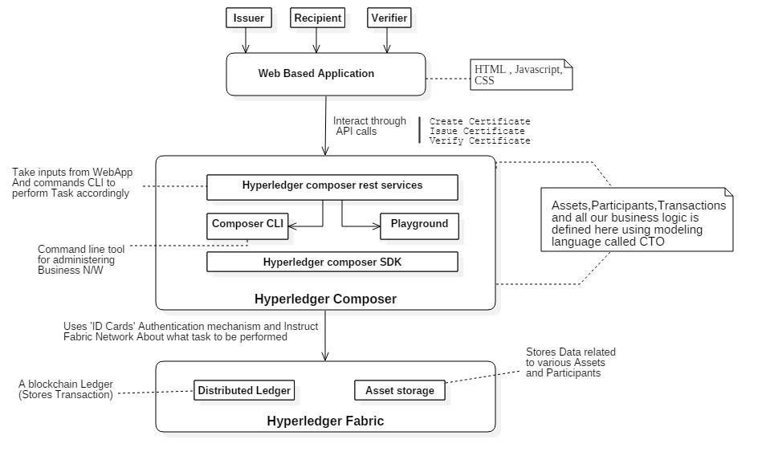
Architecture

Slide 10

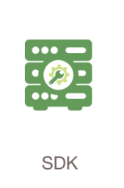
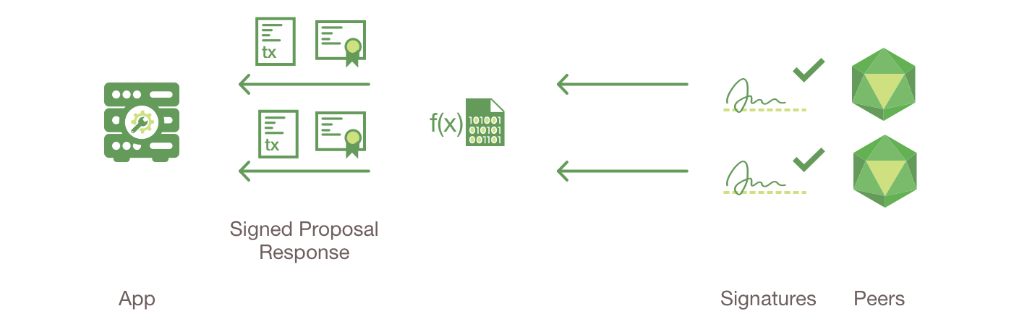


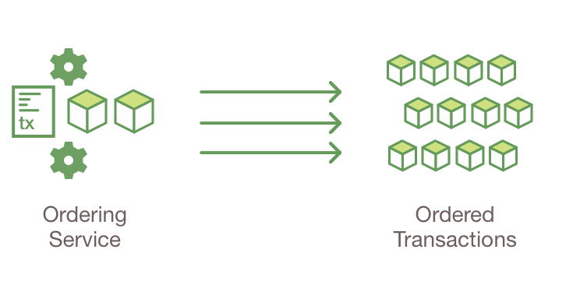
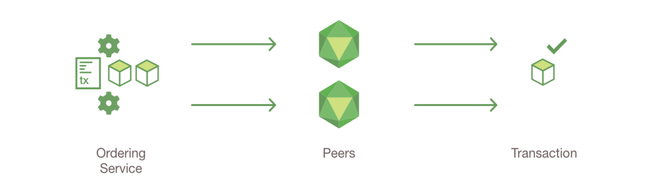

HYPERLEDGER FABRIC TRANSACTION FLOW

Slide 11

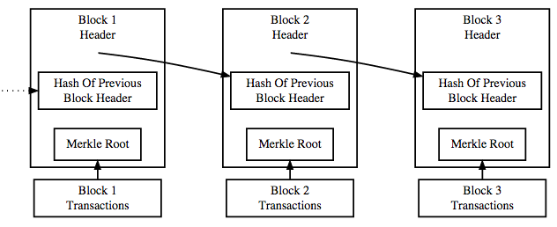


Work Flow
peer1
Submit issue transaction
to Network
Apply hash algorithm on digital certificate
10010010
11011101
Hash of certificate
peer2
peer3
1.Peers endorse transaction.
2.Ordering service create block
of transaction.
3. Send to peers to add current
block into their blockchain.
Notify the Added transaction (send transactionId of the
transaction performed to
their respective wallets)
Recipient

Slide 12
Obtaining Certificate
Contains Digital certificate encrypted with Student(Pk)
Certificate link
Stored in student wallet
Download
Digital
Certificate
Decrypt with Student(Sk)

Slide 13

Verification by employer
[x] Digital Certificate
[y] Transaction Id
[x] [y]
A. Hash( [x] )
B. Verify(y, A)
Application
Generate Event that shows correctness of certificate

Slide 14
Advantages-
-Cannot be forged.
-The certificate can be validated even if the issuer
no longer exists.
Challenges-
-The blockchain would grow significantly in size.
-There is currently a lack of common platform around the
education system.
Future Scope-
-Decentralizing the issuing authorities.
-Adding security feature for certificate sharing.

Slide 15



